Slide 1
Hierarchical Feature Fusion model based SSD For Multi-scale Text Detection
张皓然 胡帅
2019/11/21

Slide 2
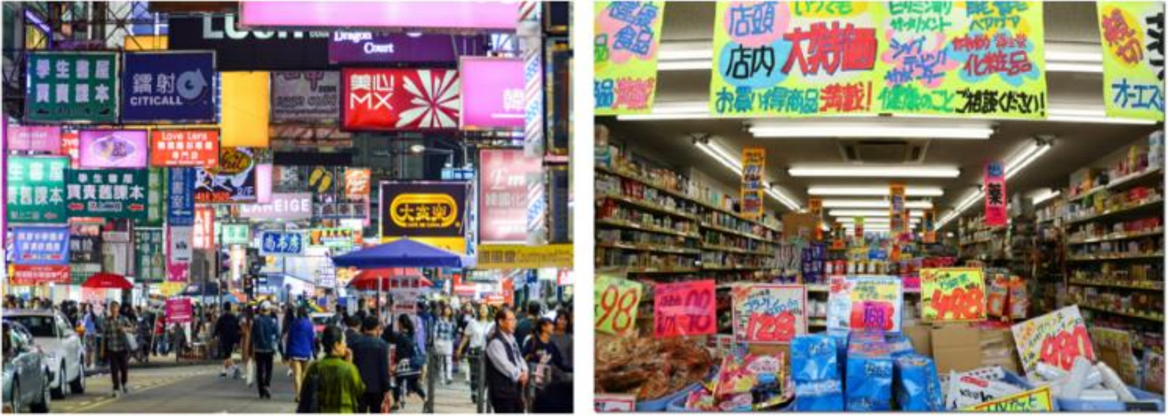
INTRODUCTION
region-based methods
divide the text detection task into two steps: Region Proposal Network (RPN) and RoI-wise Classification Network (RCN)
region-free methods
directly predict bounding boxes and their classes.
single shot detector (SSD) has shown predominance in object detection among deep learning-based methods but has limited capability in handling multi-scale text detection (MTD) task.
SSD-based methods are inefficient or inaccurate in detecting small-scale objects.

Slide 3
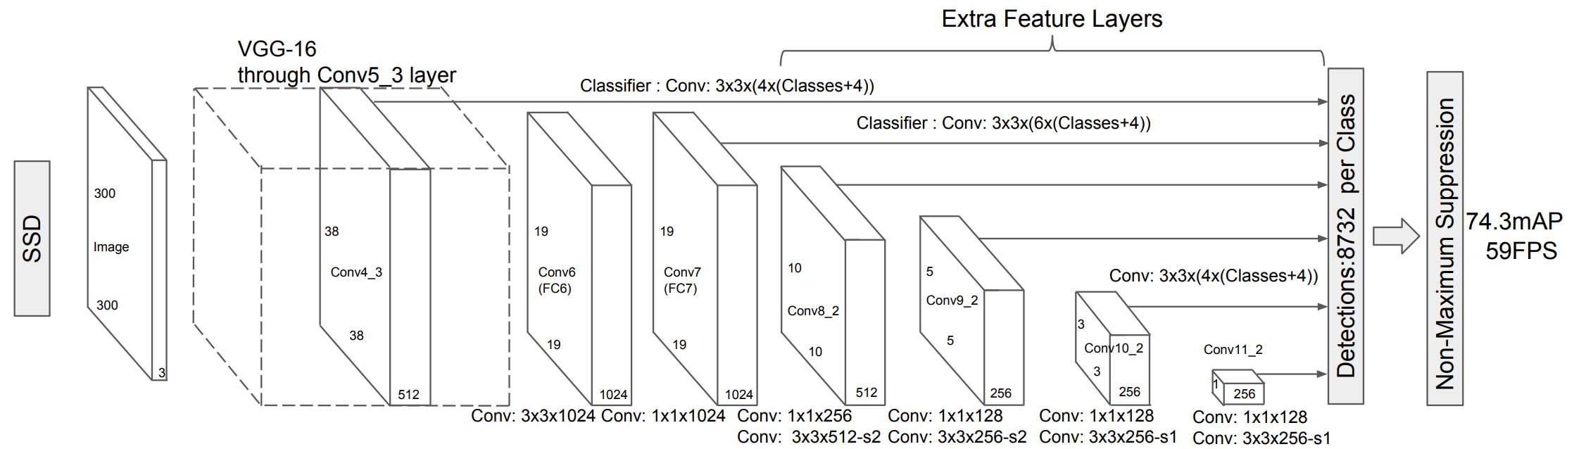
Single Shot MultiBox Detector[1]
[1]Liu, Wei, et al. "Ssd: Single shot multibox detector." European conference on computer vision. Springer, Cham, 2016.
SSD以VGG16作为基本框架，完成特征提取，有如下修改：
fc6 -> conv6(3x3)
Fc7 -> conv7(1x1)
key features:
Multi-scale feature maps for detection
Convolutional predictors for detection
Default boxes and aspect ratios

Slide 4
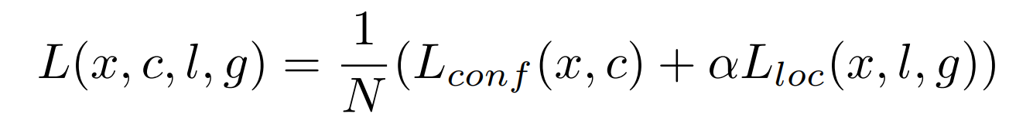
Single Shot MultiBox Detector
Matching strategy:
we then match default boxes to any ground truth with jaccard overlap higher than a threshold (0.5).
Training objective:
a weighted sum of the localization loss (loc) and the confidence loss (conf)

Slide 5
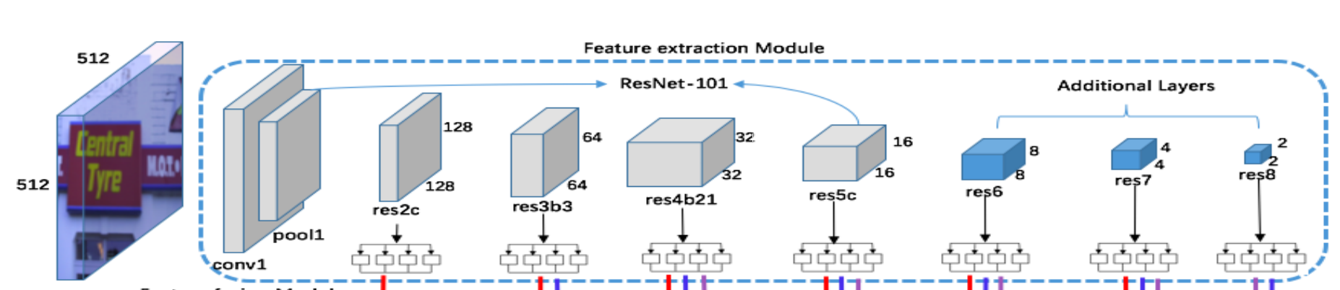
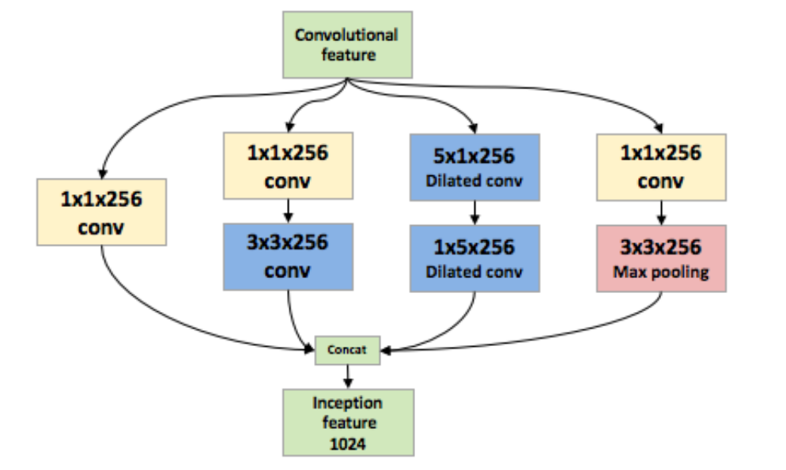
Feature extraction Module
we design an inception(GoogLeNet) module for each detection layer to capture multi-scale feature by using different sizes of convolutional kernels.
ResNet-101 is taken as the basic network instead of VGG-16 which is used in original SSD[2], keeping the layers from conv1 to res5c unchanged, and appending three additional convolutional layers, named as res6, res7 and res8, respectively.
take the last layer of each stage in ResNet-101 as the detection layers
these detection layers are denoted as res2c, res3b3, res4b21, res5c, res6, res7, and res8,
[2]Fu, Cheng-Yang, et al. "Dssd: Deconvolutional single shot detector." arXiv preprint arXiv:1701.06659 (2017).

Slide 6
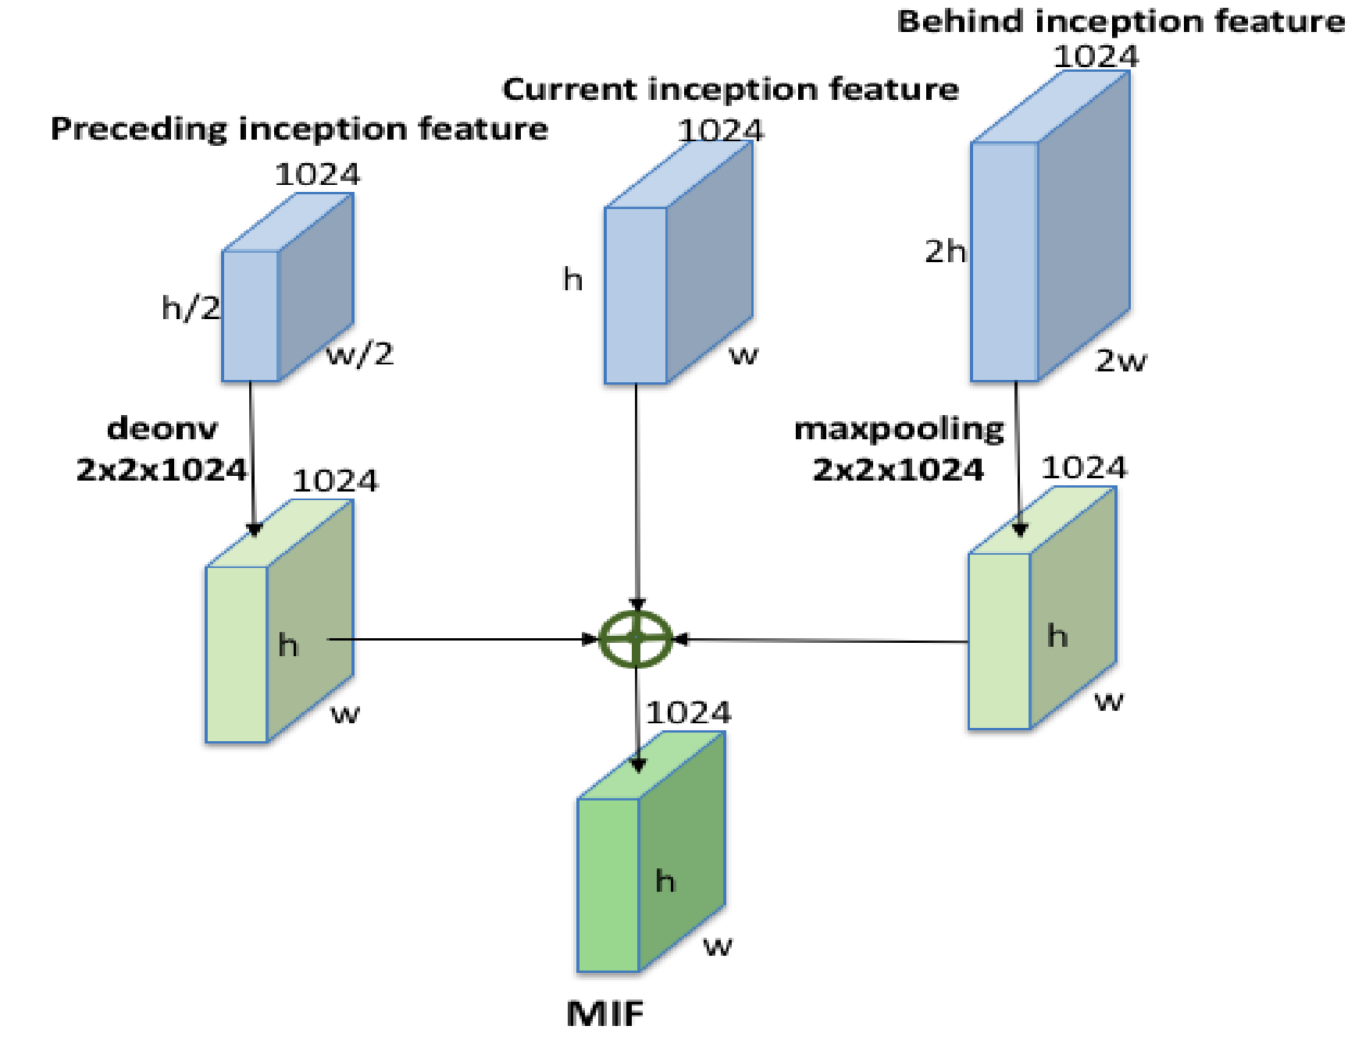
Feature fusion module
inspired by HyperNet[3]
(MIF)Multi-layer Inception Features:
the preceding inception feature layer, the current inception feature layer and the behind inception feature layer
Aim:incorporating semantic and contextual information in feature maps
multi-level feature fusion
It is a fact that the lower layers feature maps are of higher resolution containing abundant details but less semantic information. To improve the small-scale texts detection capability, the abstract semantic features from higher layers are fused into the lower layers.
MIF-5 and MIF-6 are up-sampled which are fused with MIF-1 and MIF-2 respectively
[3]B. Hariharan, P. Arbelaez, R. Girshick, and J. Malik,
"Hypercolumns for object segmentation and fine-grained
localization," in IEEE Conference on Computer Vision
and Pattern Recognition, 2015, pp. 447-456.

Slide 7
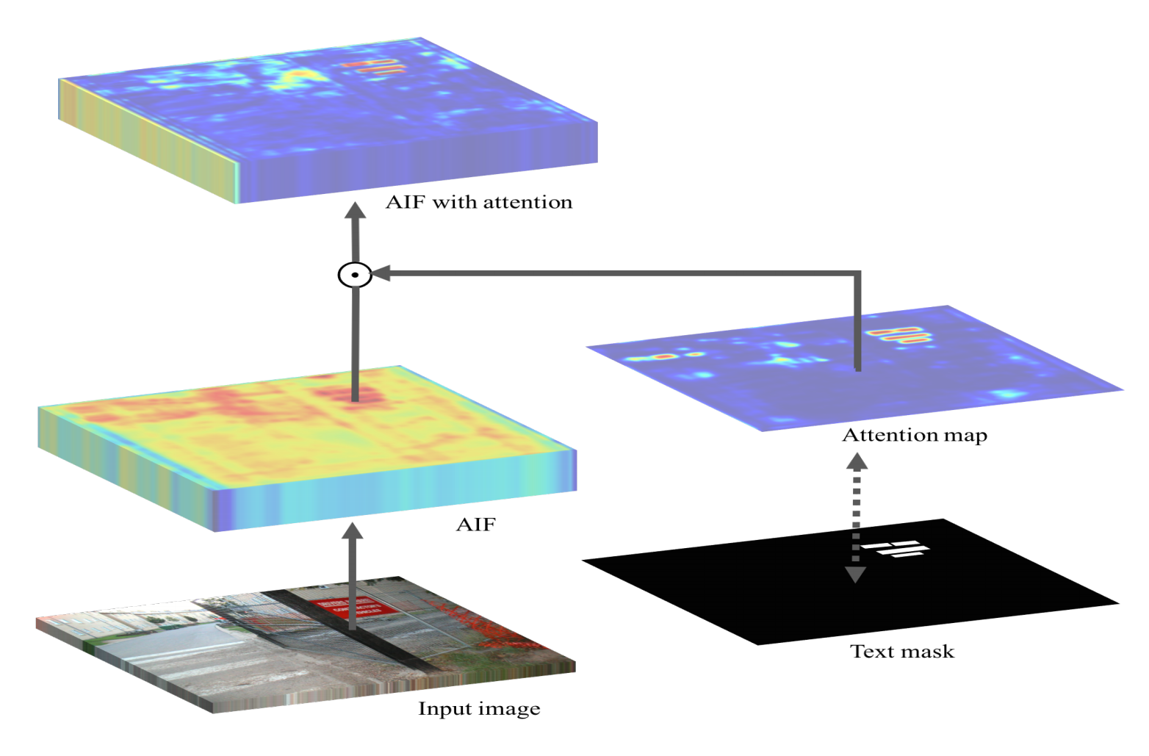
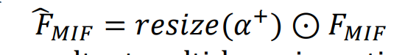
Text attention module[4]
employ the text attention module trying to learn the probability heat map of texts
learn the spatial regions of text from MIFs
[4]He, Pan, et al. "Single shot text detector with regional attention." Proceedings of the IEEE International Conference on Computer Vision. 2017.

Slide 8
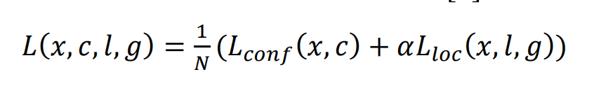
Word prediction module
modify the original aspect ratios
(0.5, 2, 3, 4, 5, 7, 9, 11)

Slide 9
Feature fusion module
e batch size is set to 32, with a momentum of 0.9. We initialize our model using the pre-trained model in [17]. The learning rate is set to 0.001 and is decayed to its 1 10 after 15, 000 iterations.

Slide 10
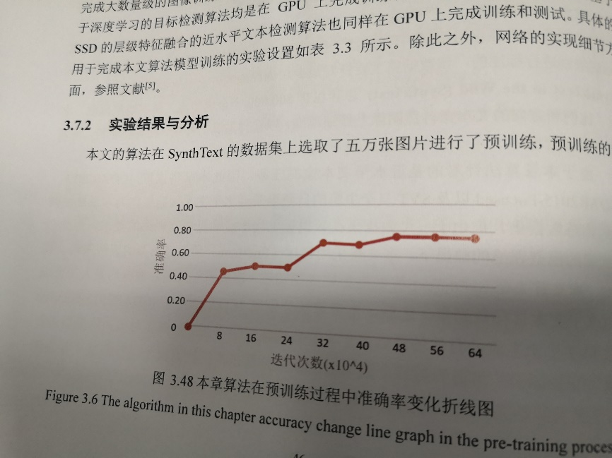
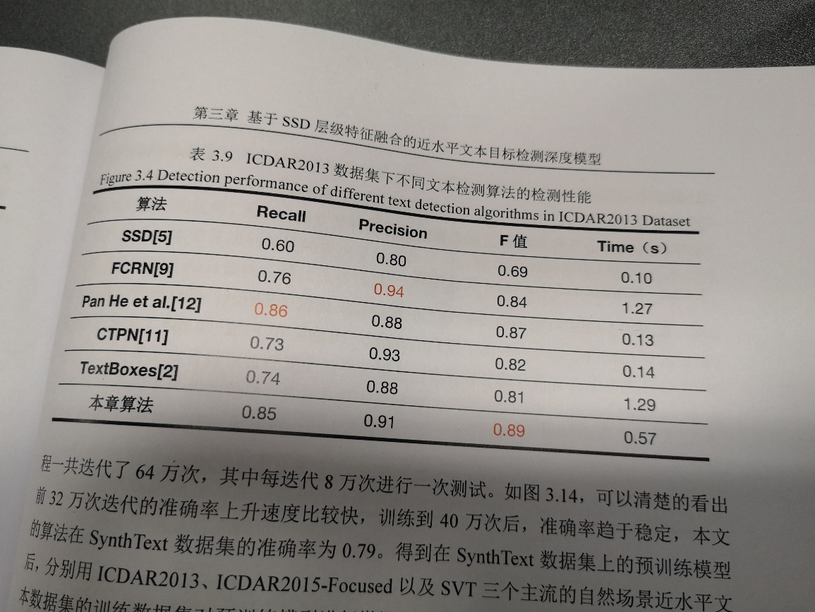
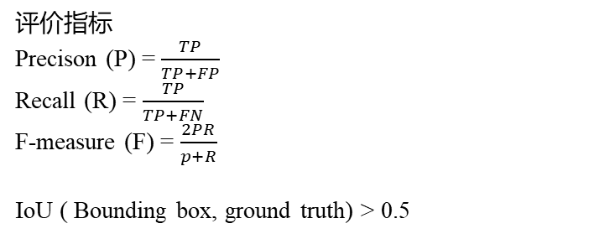
评价指标
Precison (P) = $\frac{TP}{TP+FP}$
Recall (R) = $\frac{TP}{TP+FN}$
F-measure (F) = $\frac{2PR}{p+R}$
IoU ( Bounding box, ground truth) > 0.5
Dataset & 实验设置
ICDAR 2013 229 train pics /223 test pics
Fintune the model pretrained with Synth Text (800,000 合成图片)
Lr=0.0001(multistep), weight_decay=0.0005,momentum=0.9
64万次迭代，每8万次进行一次测试，最后在Synth Text上 准确率为0.79
Detections performance of different text detection algorithms in ICDAR2015 dataset

Slide 11
Comparsion of detection results

Slide 12
Thanks for your attention!

